Slide 1
The busy little Arduino in the TC1
A short tour

Slide 2
physical components
to: ((py)j)amaseis
analog
amplifier
arduino
USB
pickup
coil

Slide 3
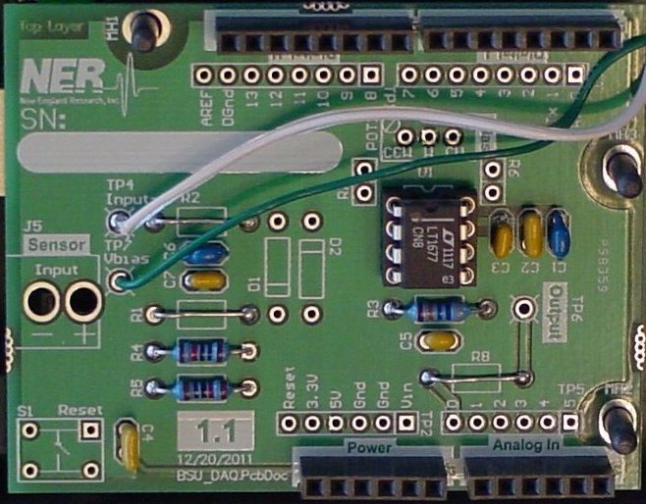

Slide 4
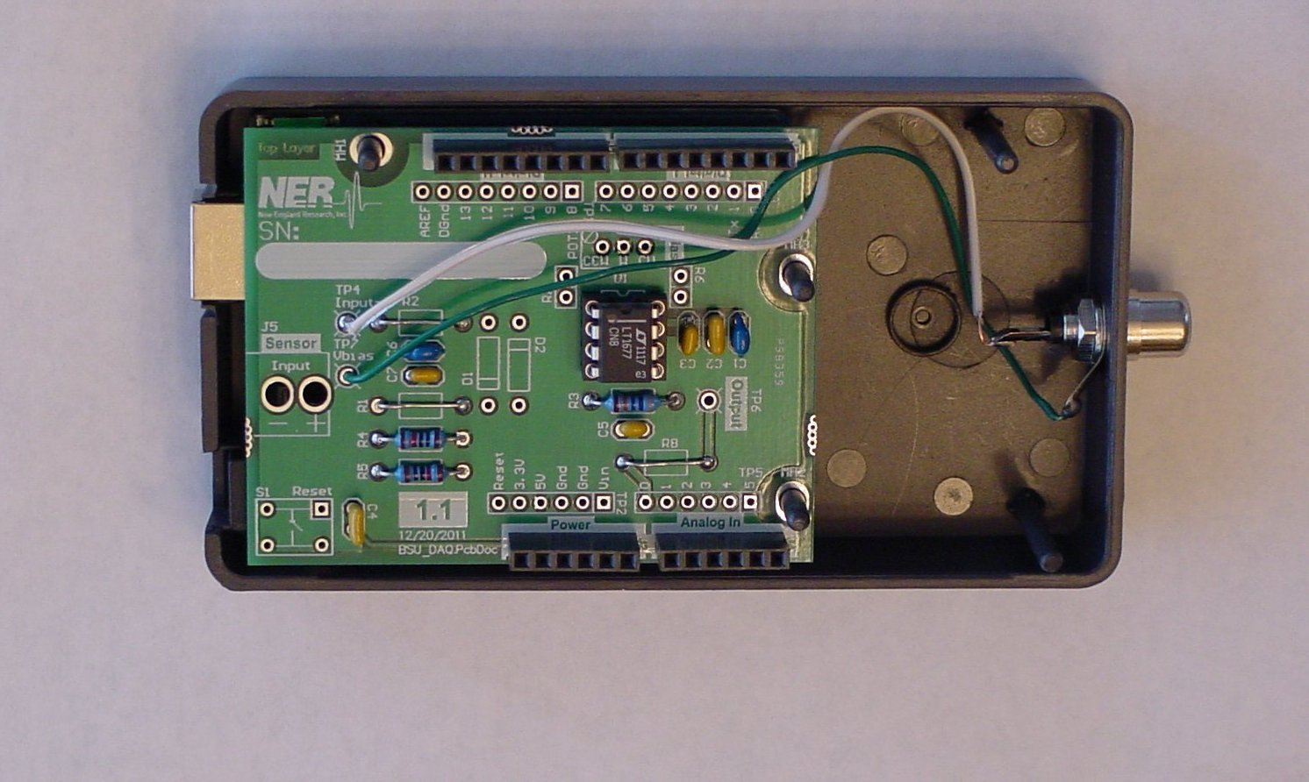

Slide 5
9615.4 interrupts
each second
main
arduino
program
output
analog
digital
analog to digital
converter
18.78/second

Slide 6
Sample arithmetic
We acquire 9615.4 samples/second from the TC1’s sensor
We send 18.78 samples/second to the computer over the USB cable
Each output sample is the average of 2048 input samples

Slide 7
Averaging madness
Massive averaging has two principal benefits in the TC1
reduces some types of noise in the data
greatly improves the resolution of the data
resolution is the smallest change we can measure

Slide 8
The Arduino also
applies three digital filters to the data that
remove long-term drift
reduce electrical noise
boost part of the long-period signal

Slide 9
How busy is our Arduino?

